Slide 1
Convex Hull problem

Slide 2
Convex vs. Concave
A polygon P is convex if for every pair of points x and y in P, the line xy is also in P; otherwise, it is called concave.
P
x
y
x
P
y
concave
convex

Slide 3
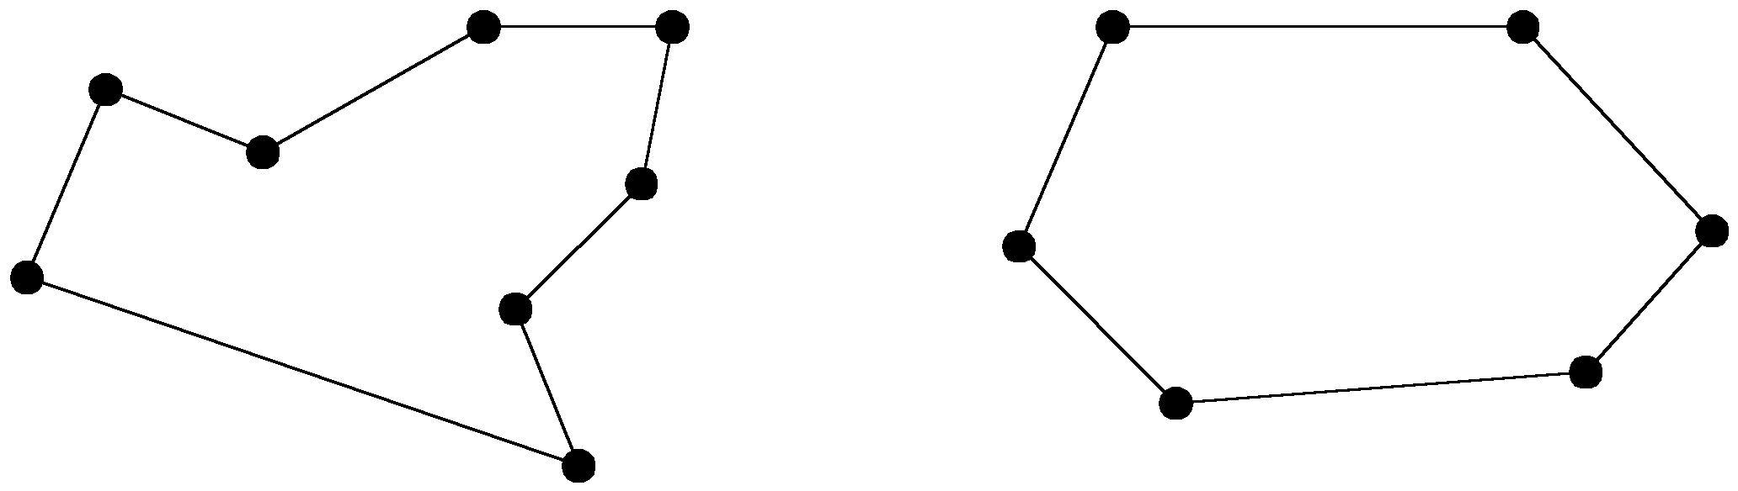
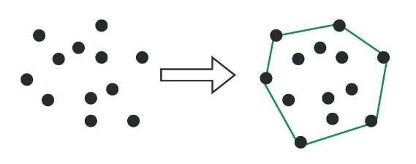
The convex hull problem
The convex hull of a set of planar points is the smallest convex polygon containing all of the points.
concave polygon:
convex polygon:

Slide 4
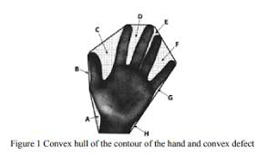
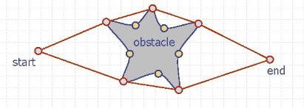
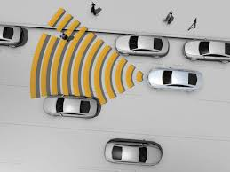
Applications of Convex Hull
Collision detection: Convex hulls can be used to efficiently detect collisions between objects in 2D or 3D space.
Image processing: Convex hulls can be used to extract meaningful shapes from images, such as the outline of an object.
Data visualization: Convex hulls can be used to visualize the distribution of data points in a scatter plot.

Slide 5
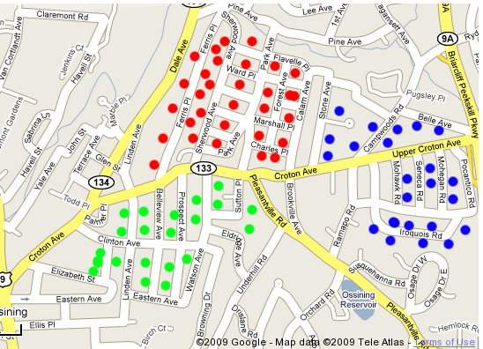
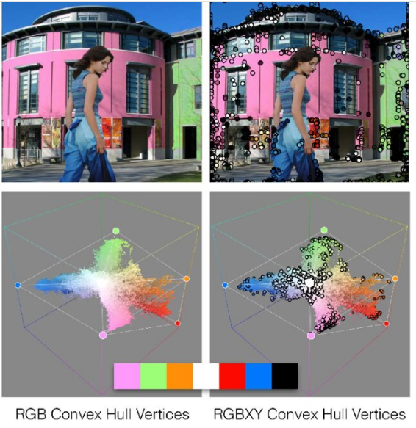
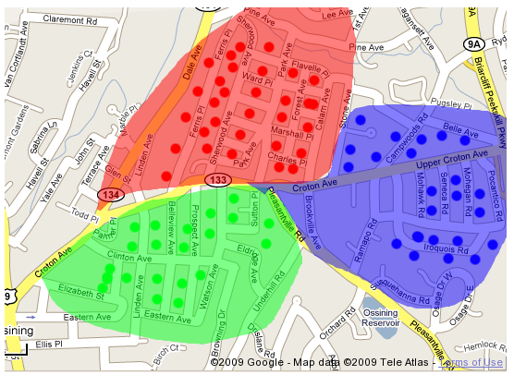
Applications of Convex Hull

Slide 6
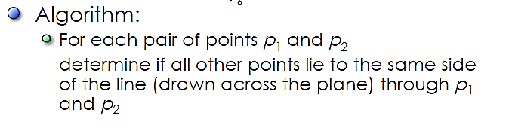
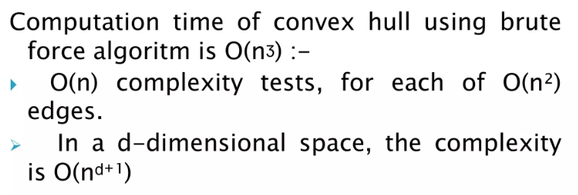
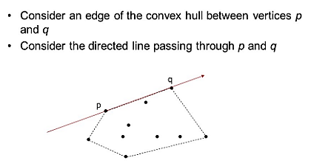

Brute Force Approach for Convex Hull

Slide 7
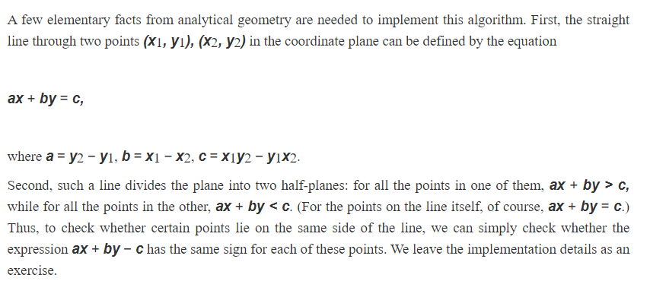
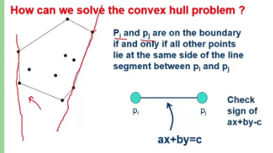
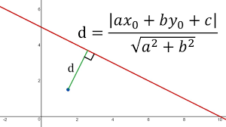
Elementary facts from geometry
Farthest Point

Slide 8
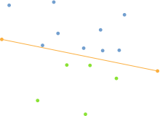
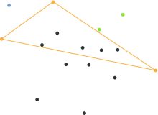
QuickHull: Convex-Hull by Divide and Conquer
Select p1 with smallest x- and p2 with largest x-coordinate. p1 and p2 are in the Convex-Hull. Let p1p2 be the line connecting p1 and p2.
1. Divide points in P as follows:
L: those that are to the “left” of p1p2.
R: those that are to the “right” of p1p2
2. Find the point pL in L which is the farthest from p1p2. If tides occur, select the one that maximizes the angle between p1p2 and p1pL . pL is in the Convex-Hull
3. Find the point pR in R which is the farthest from p1p2. If tides occur, select the one that maximizes the angle between p1p2 and p1pR . pR is in the Convex-Hull
4. Repeat 1 with:
p1pL and L
p1pR and R
.
Step 1
Step 2

Slide 9
QuickHull: Convex-Hull by Divide and Conquer

Slide 10
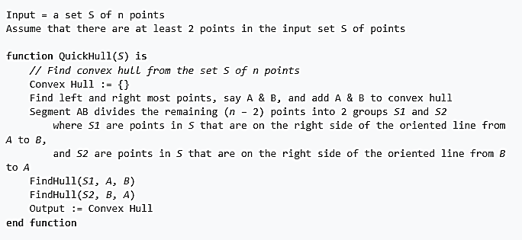
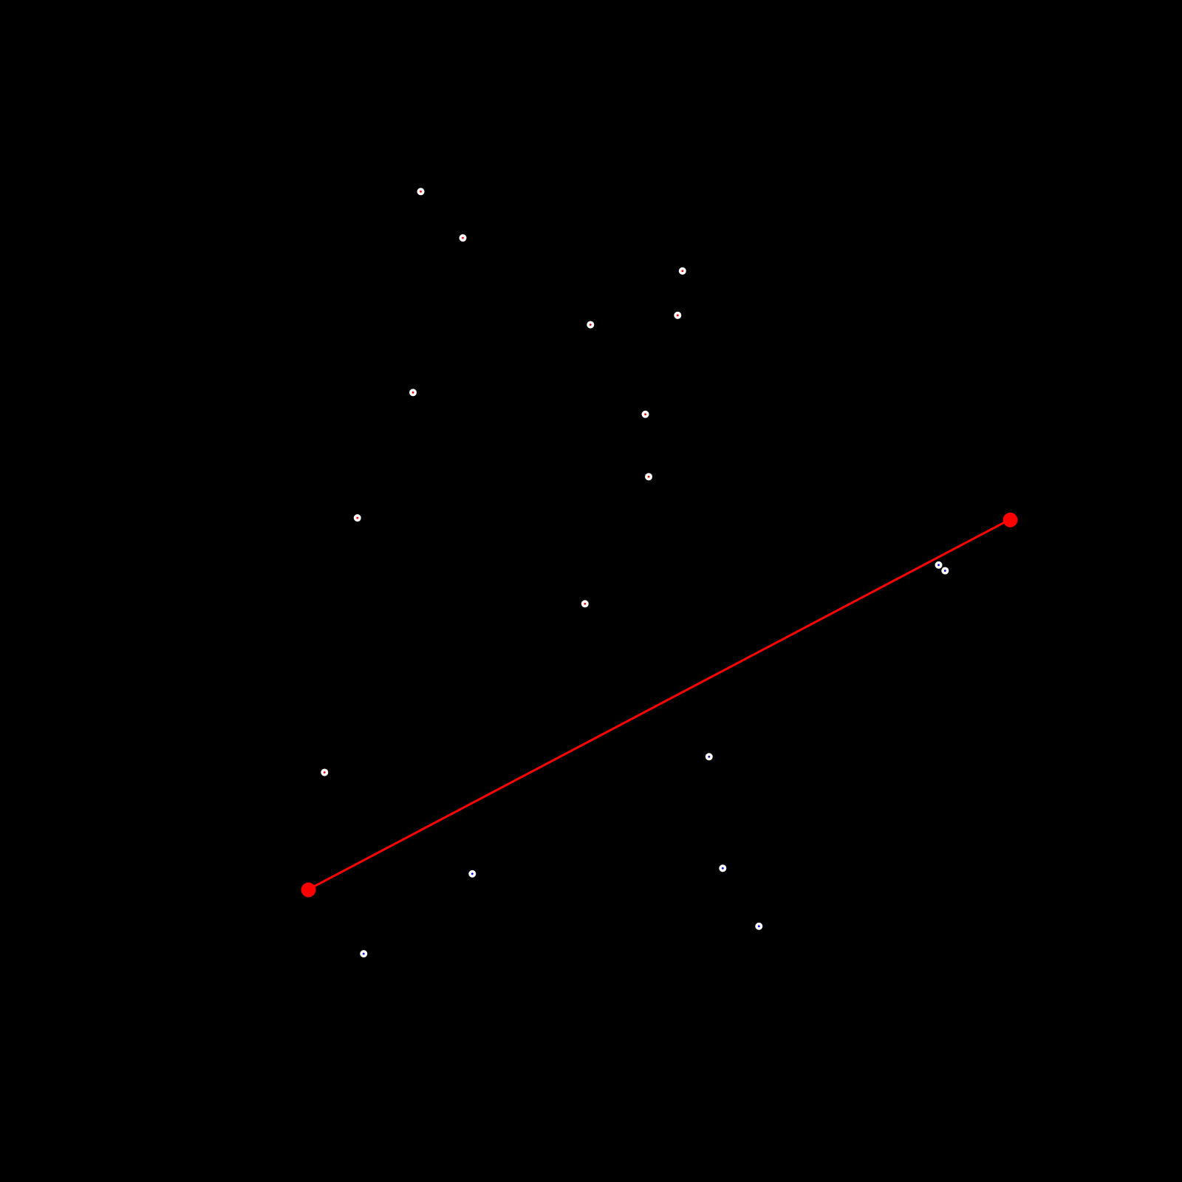

Quick Hull Pseudo code

Slide 11
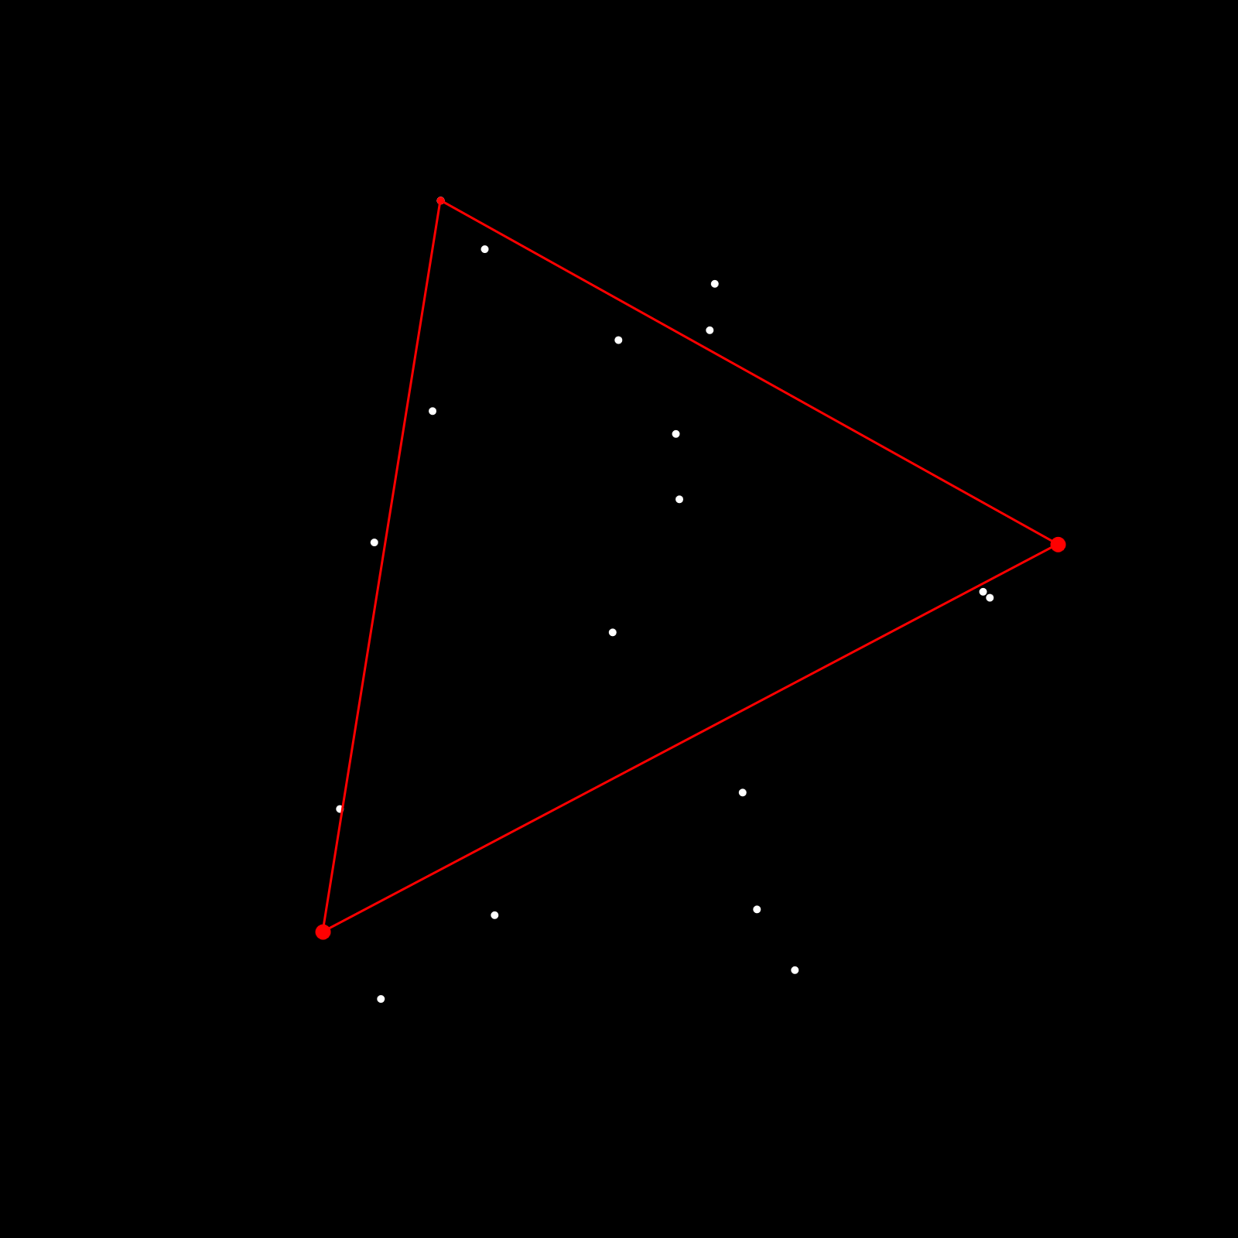
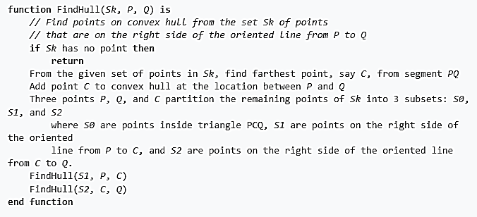
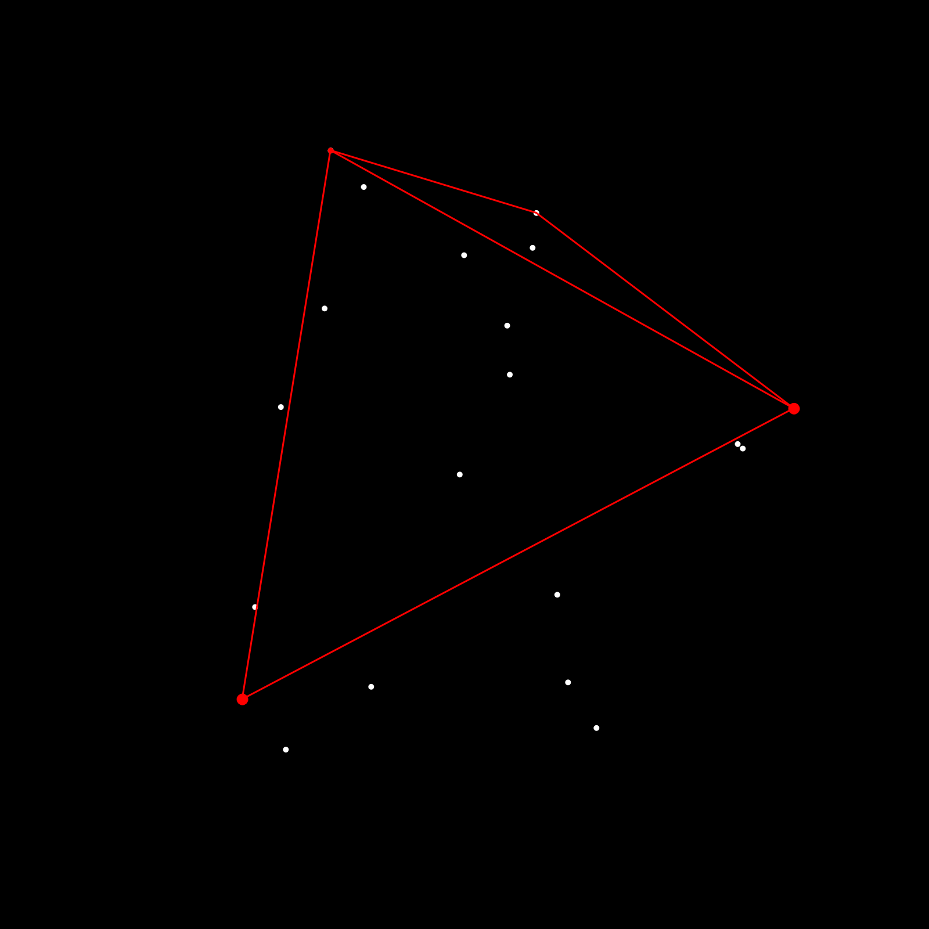
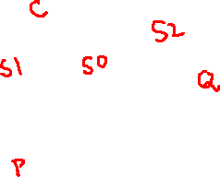
Quick Hull Pseudo code (contd…)

Slide 12
Time complexity of Quick Hull
Sort points in P by the x coordinate O(n log₂n)
Recursive Divide and Conquer process
average case: O(n log₂n)
worst case: O(n²)

Slide 13
References
https://learnopencv.com/convex-hull-using-opencv-in-python-and-c/
https://www.brainkart.com/article/Closest-Pair-and-Convex-Hull-Problems-by-Brute-Force_8012/
https://www.gorillasun.de/blog/quickhull-algorithm-for-convex-hulls/

